Slide 1
B.E. Project Presentation
Group Members:
BC C – 04 Kadekar Sakshi Sunil
BC C – 05 Sonavane Shraddha Raghunath
BC C – 06 Jawale Shruti Uday
BC C – 07 Nimase Adesh Nandu
Guided By: Prof.V.S.Kadam

Slide 2

PROJECT TITLE :
V app:
E college system for Blind Student

Slide 3
PROBLEM STATEMENT :
Visually impaired students faces challenges in accessing educational content online. Current platforms lack tailored accessibility features, impeding their ability to participate fully in academic activities. Therefore there is need of text-to-speech based functionality based system helping blind students to navigate and retrieve this information using voice commands.

Slide 4
Motivation:
The "E College System for Blind Students" project is driven by the commitment to provide equal educational opportunities for visually impaired students. By incorporating innovative features like text-to-speech and voice commands, the project aims to break down digital barriers, empowering students to access educational materials independently.

Slide 5
PROJECT OBJECTIVES :
Develop an Accessible E College System:
Create an innovative digital platform specifically designed for visually impaired students, ensuring it is user-friendly and accessible using voice commands.
Implement Text-to-Speech Functionality:
Integrate a robust text-to-speech feature, allowing the system to convert text into spoken words, facilitating auditory learning for visually impaired students.
Teacher Administrative Tools:
Develop an intuitive interface for teachers to input and manage academic schedules, notices, events, and reminders, enhancing the efficiency of administrative processes.

Slide 6
PROJECT OBJECTIVES :
Promote User Independence:
Design the system to promote independence among visually impaired students, enabling them to manage their academic schedules, access course materials, and receive notifications autonomously.
Equal Access to Education:
Ensure visually impaired students have equal access to educational resources, fostering inclusivity and empowering them with educational opportunities equivalent to their sighted peers.

Slide 7
Liturature Survey :
Title of Paper | Author | Outcomes | Future scope | Remark
Be My Eyes: Android App For Impaired People | Rucha Doiphode, Mayuri Ganore, Ashwini Garud, Tejaswini Ghuge, Parmind er Kaur | This project demonstrates the idea of messaging and calling system for visually impaired people. | Expanding language support to include more languages and dialects to serve a more diverse global audience. | Ultimately aiming to provide even more comprehensive assistance and empowerment for its users.
Intelligent eye: A mobile application for assisting blind people | Milios Awad, Jad El Haddad, Edgar Khneisser, Tarek Mahmoud, Elias Yaacoub, Mohammad Malli | The application provides assistance to visually impaired people by providing a set of useful features: light detection, color detection, object recognition, and banknote recognition | Addressing data security and consent issues. | consideration of accessibility, privacy, and accuracy

Slide 8
Liturature Survey :
AI Based App for Blind People | Tufel Ali Qureshi1, Mahima Rajbhar2, Yukta Pisat3, Prof. Vijay Bhosale | The system presented in the paper uses artificial intelligence in real time to help the visually disabled people to navigate their environment independently. | Providing effective training to make the app usable is essential. | Addressing these remarks will help enhance the clarity, impact, and relevance of your research.

Slide 9
Scope :
The scope of the "E College System for Blind Students" project encompasses the development of a user-friendly digital platform tailored specifically for visually impaired students. The system will include modules for students and teachers, integrating essential features such as text-to-speech functionality, voice command interactions, real-time notifications, and accessible administrative tools.
It can provide easy access to essential academic information, including class schedules, lecture notes, and assignment tracking.

Slide 10
Requirement Analysis :
User Requirements:
Students:
Access to educational materials via text-to-speech functionality.
Ability to navigate the system using voice commands.
Real-time notifications for class schedules, notices, events, and reminders.
Teachers:
Intuitive interface for adding and managing schedules, notices, events, and reminders.
Secure login with role-based access for administrative tasks.

Slide 11
Requirement Analysis :
2.Functional Requirements:
Text-to-Speech Feature:
Convert written text into spoken words for educational materials.
Voice Command Interactions:
Enable users to perform tasks and access information using natural language voice commands.
Administrative Tools:
Allow teachers to input and manage class-related information effortlessly.
3.Technical Requirements:
Programming Language: Utilize Kotlin for Android app development.
Database: Implement Firebase or a similar real-time database for secure data storage and synchronization.
Accessibility Tools: Integrate screen readers, voice recognition APIs, and other accessibility features.

Slide 12
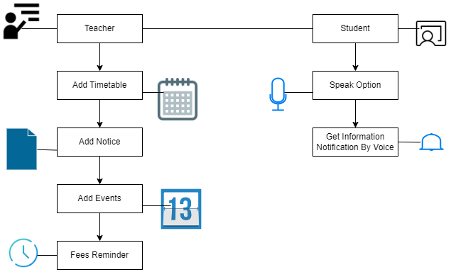
SYSTEM DIAGRAM :

Slide 13
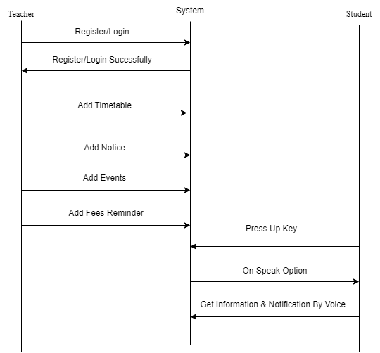
SEQUENCE DIAGRAM :

Slide 14
Conclusion :
The 'E College System for Blind Students' is not just a technological innovation; it represents a commitment to inclusivity and equal educational opportunities. By addressing the unique needs of visually impaired students through text-to-speech, voice commands, and real-time notifications, this project not only breaks digital barriers but also fosters independence and confidence.

